Slide 1
Where does 'sustaining' open source fall down?
Richard Littauer

Slide 2
Who is Richard Littauer anyway?
Linguist and Latin tutor
Developer
"Community manager"
Worked for: Hipcamp, MIT, Johns Hopkins, Protocol Labs, the OSI, Open Source Collective, the Digital Infrastructure Fund…
Currently: SustainOSS

Slide 3
What we're going to cover
SustainOSS
What sustainable means in various contexts
What to wonder when you hear the word
What's after "Is this sustainable?"

Slide 4

What is SustainOSS?
A community of people trying to figure out how to keep OSS sustainable
Conferences
Working groups
Podcasts

Slide 5
"Sustainers"
The individual or organization who is concerned with the current state and future of highly-used and impactful open source projects.
Notes:
This doesn't get to the core of what sustaining open source would mean, it just talks about concern for the state or future, and limits its scope.

Slide 6
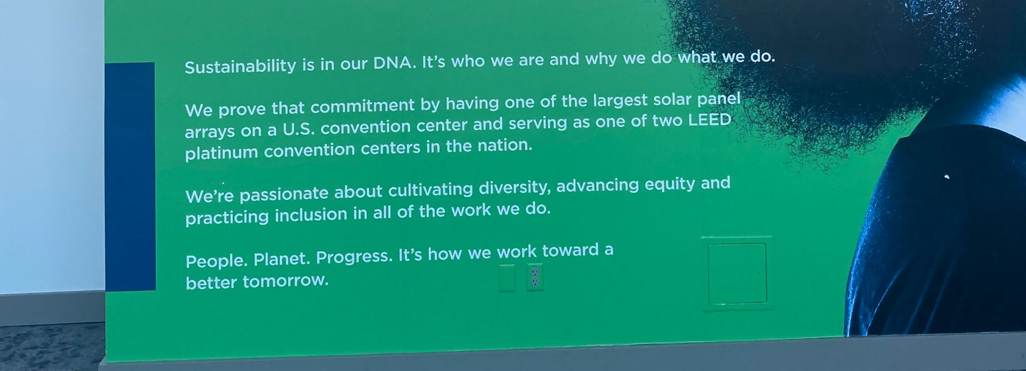
What is Sustainability?

Slide 7
Where sustainability applies in FOSS:
Projects
Developers
Communities
Businesses
Academia
Ecosystems
Environment
Notes:
Let's go over these in depth, to see how it is applied.

Slide 8
Sustain: FOSS Projects
Growth
Diversity
Funding

Slide 9
Sustain: FOSS Projects
Growth
  More in than out
  Pathways to maintainer
  Product management and design planning
  Goal: capturing market share of attention

Slide 10
Sustain: FOSS Projects
Diversity
  Welcoming community spaces
  CoCs
  Documentation
  Moderation
  Mentoring
  Goal: towards some ethical destination

Slide 11
Sustain: FOSS Projects
Funding
  Funding for the project costs
  Funding for the core maintainers
  Lifestyle funding
  Funding for all contributors
  Non-fiscal sponsorships

Slide 12
Sustain: FOSS Developers
Satisfaction
Career trajectories
Mentoring
Funds and recognition
Avoiding burnout

Slide 13
Sustain: FOSS Communities
Not always tied to a project
Functionally similar to what we talked about above

Slide 14
Sustain: FOSS Businesses and Corporate
Focus: a bottom line
Not pushing OSS onto your employee's private time
Having advocates and marketing inside the company for open source
OSPOs
"Collaboration"

Slide 15
Sustain: FOSS Academia
Not quite the same as industry or "open source"
Reproducibility
Citations and altmetrics
The project- or funding-based cycles of OSS in academia
The student-graduation cycle of academia
Where support comes from in the institution

Slide 16
Sustain: FOSS Ecosystem
Funding maintainers for their work
Security and supply chains
The "digital commons"

Slide 17
Sustain: FOSS Ecosystem
Legal sustainability and licenses
  Stopping proliferation
  Open washing
  Patent issues
AI + open source
Taxation and infrastructural funding
The CRA and their ilk

Slide 18
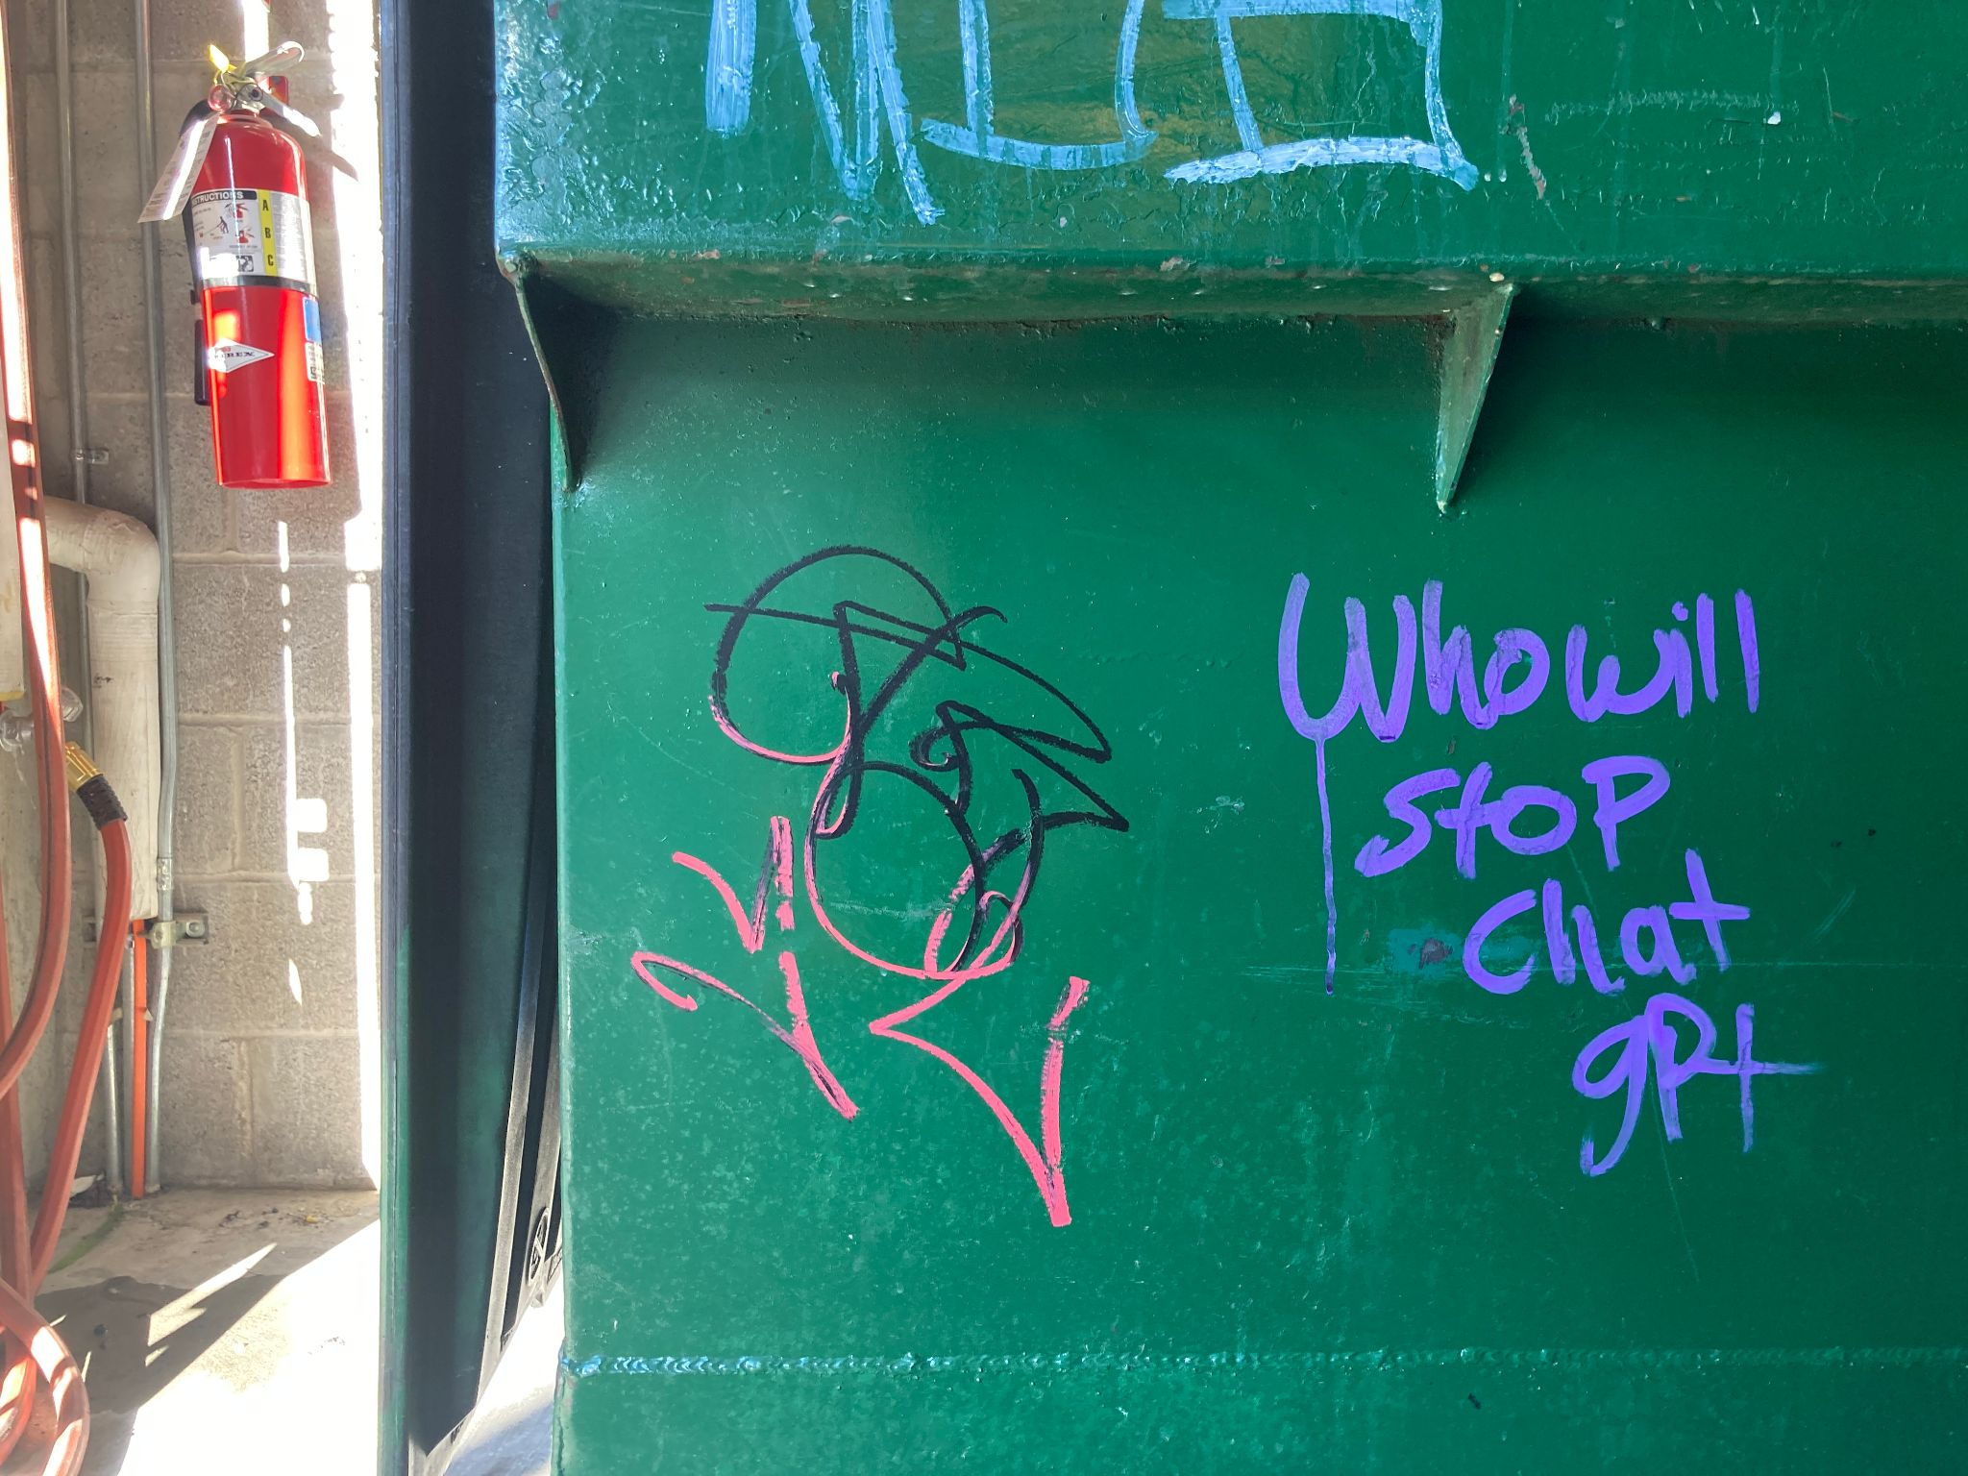
Sustain: FOSS Ecosystem

Slide 19
Sustain: FOSS & Environment
Open source hardware
Carbon-neutral data storage centers
Reducing server costs
Not using bitcoin
Avoiding the conference trap

Slide 20
Sustain: FOSS & the whole environment
Tech for environmental activists
Tech for environmental studies
Use of tech for the planet as a whole

Slide 21
Sustain???
At this point, it should be clear that "sustainability" is being overused and is somewhat semantically bleached.

Slide 22
When you see "Sustain", ask:
For what?
For whom?
For how long?
From what original state?
Why this term?

Slide 23
What's at risk?
Projects
Developers
Communities
Businesses
Academia
Ecosystems
Environment
Notes:
These are all largely issues of scale: 1, a few, many, and then all of us.
- They're also all coherent issues - that is, they cover the entire project

Slide 24
Sustain covers all manner of sins.
Was it healthy to begin with?
Were people treated well?
Were practices ethical?
What about all of the stuff we talked about above?

Slide 25
What does "sustain" mean, anyway?
Temporal term
It ignores:
  End-of-life cycles for software projects
  End-of-life cycles for software ecosystems
  Boom-and-bust cycles for fads

Slide 26
"Sustain" fails to recognize:
Current achievements
Creative output
The bigger picture.

Slide 27
The bigger picture:
Life on earth is dying.
Things are mildly OK for some humans right now.
The heat death of the universe.

Slide 28
The bigger picture:
Every piece of software you love will die and be forgotten.

Slide 29
So, what matters?
Ennoble human nature
To act cooperatively and with an egalitarian mindset
To make life more meaningful
To mitigate and reduce pain and suffering.

Slide 30
Instead of saying "Sustain!", ask:
Does my personal development life / project / ecosystem / business contribute to the happiness of myself and others?
Does it recognize, validate, and protect basic living rights?
Does it reduce harm?
Does it increase capacity for wonder, awe, and joy?

Slide 31
What gets measured is what is valued.
How are you measuring joy?
How are you measuring wonder?
How are you measuring impact on real lives?
How are you working towards improving those metrics?

Slide 32
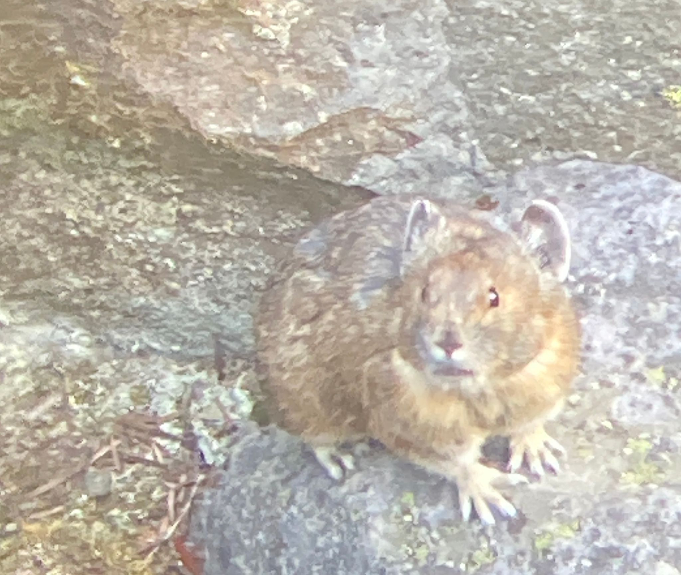
Thanks.
Here's a Pika.

